Slide 1

Spring Cloud – Client-side Load Balancing
Distribution of workloads across multiple computing resources

Slide 2
Outline
Calling service using client-side Load Balancing
Load balancing
Server side
Client side
Netflix Ribbon
With and Without service discovery
@LoadBalanced
@RibbonClient
Custom Ribbon configuration

Slide 3
What is Load Balancing?
Load Balancing
“... improves the distribution of workloads across multiple computing resources...”

Slide 4
What is Load Balancing?
What is the role of Load Balancing plays in a cloud native architecture?
A very Important one Actually!

Slide 5
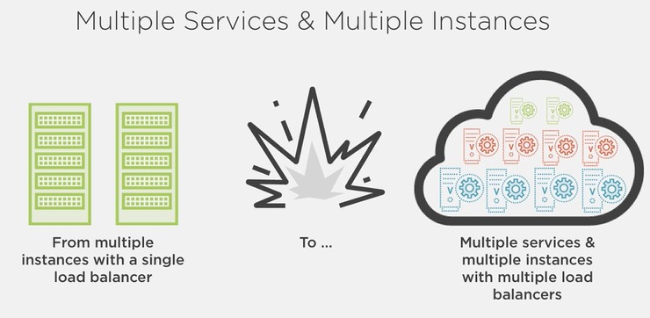
Role

Slide 6
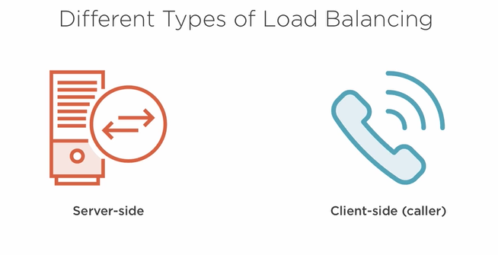
Types

Slide 7
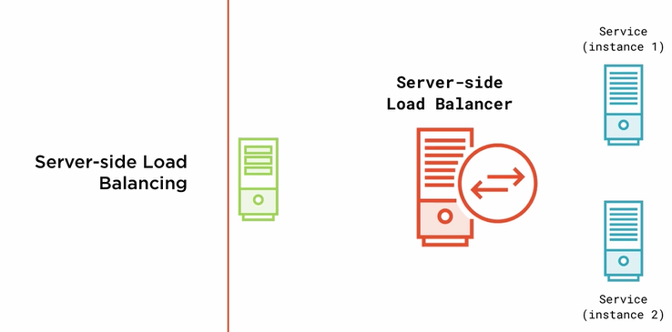
Server side Load Balancing
Server-side Load Balancing
The traffic is sent to a dedicated service that decides where to send the traffic, using an algorithm like round-robin, to one of the many instances. Examples of server-side load balancers are hardware-based ones like the devices from F5 Networks or software-based ones like AWS's ELBs.

Slide 8
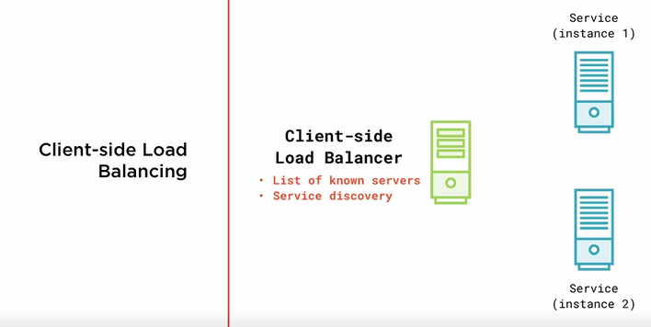
Client side Load Balancing

Slide 9
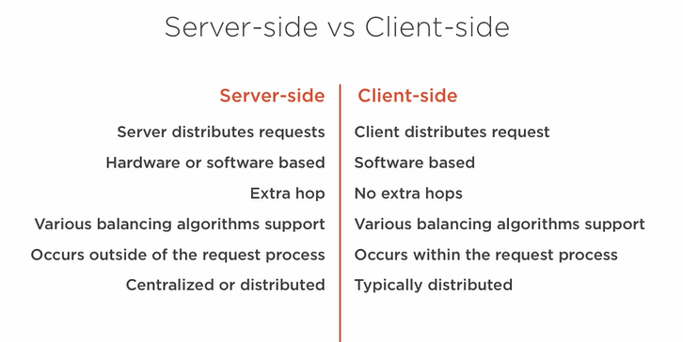
Server-side vs. Client-side
Client side load balancing is a natural fit for cloud native architectures.

Slide 10
Client side Load Balancing with Spring Cloud
Netflix Ribbon
Ribbon is a inter process communication ( Remote procedure calls ) library with built in software load balancers.
Spring cloud provide
Full Integration with Netflix ribbon to Spring's RestTemplate
Customize configuration for different
Balancing algorithms
Availability checks

Slide 11
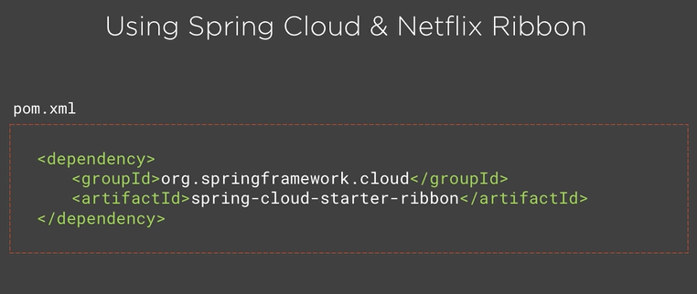
Ribbon

Slide 12
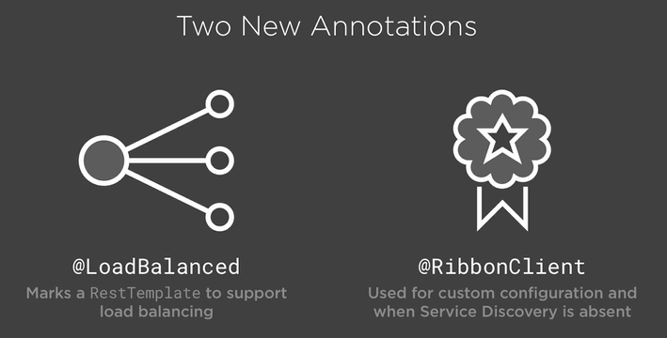
Ribbon

Slide 13
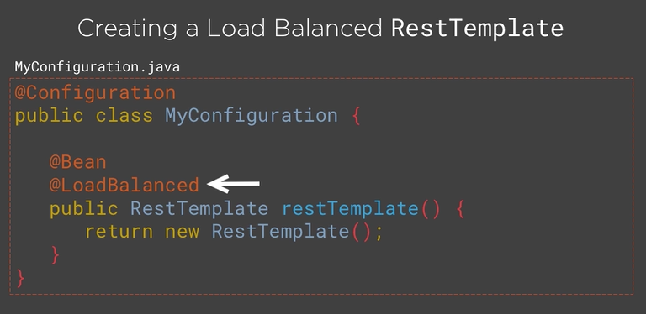
Ribbon
The RestTemplate which is returned will actually have an interceptor ( A RestTemplateInterceptor ) that utilize the ribbon load balancer client to call our services and balance between the different instances.
By default it will use a Round Robin Algorithm for distributing the request.

Slide 14
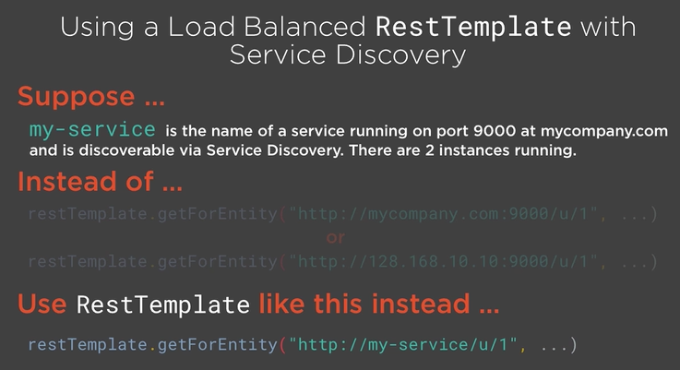
Ribbon

Slide 15
Demo
In This Demo.
We will use Ribbon client that utilize the service discovery and balances request between multiple instances of a service.
Since we will be using service discovery to locate the instance of the service, we need to have a service-discovery server setup.

Slide 16
Demo ribbon-time-service
Create Starter Project
Name : ribbon-time-service
Dependencies
web , eureka-discovery

Slide 17
Demo ribbon-time-service
Annotate main class with
@EnableDiscoveryClient
@RestController
public class TimeServiceRestController {
@Value("${server.port}")
private int port;
@RequestMapping("/")
public String getCurrentTime() {
return "The current time " +
new Date().toString()+
" service running on "+port;
}
}

Slide 18
Demo ribbon-time-service
application.properties
spring.application.name=time-service
eureka.client.service- url.defaultZone=http://localhost:8761/eureka

Slide 19
Code ribbon-time-app
Create Starter project
Name : ribbon-time-app
Dependencies
web , eureka-discovery , ribbon
Annotate main class
@EnableDiscoveryClient

Slide 20
Code ribbon-time-app
@Bean
@LoadBalanced
public RestTemplate restTemplate(){
return new RestTemplate();
}

Slide 21
Code ribbon-time-app
In RestController
@Autowired
private RestTemplate restTemplate;
@GetMapping
public String getTime(){
return restTemplate.getForEntity("http://time-service",String.class).getBody();
}

Slide 22
@RibbonClient without Service Discovery

Slide 23
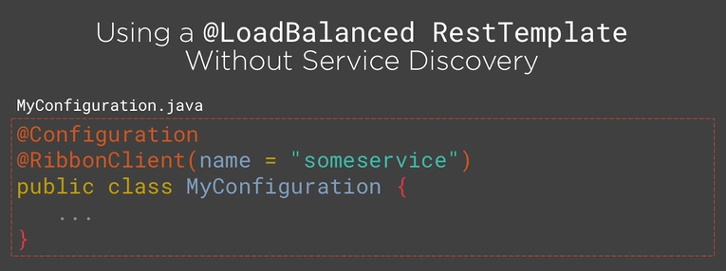
@RibbonClient

Slide 24
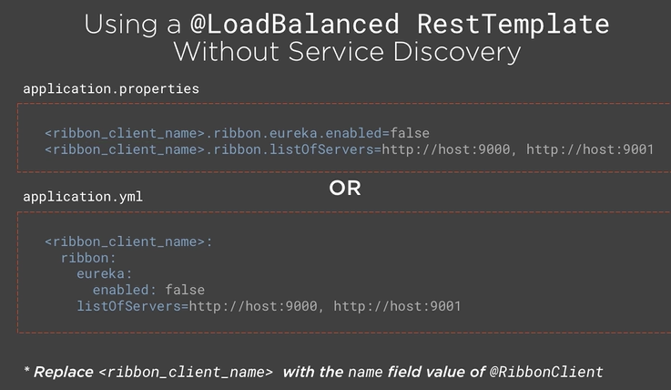
@RibbonClient

Slide 25
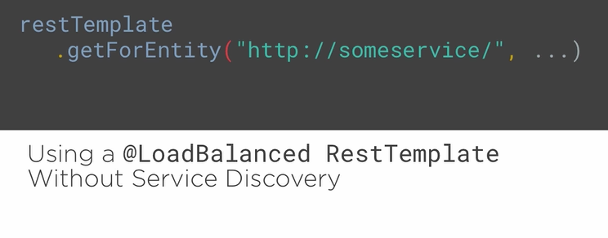
@RibbonClient

Slide 26
Custom Ribbon client Configuration

Slide 27
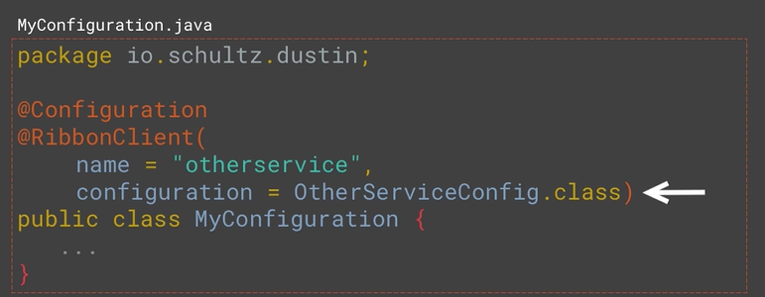
@RibbonClient

Slide 28
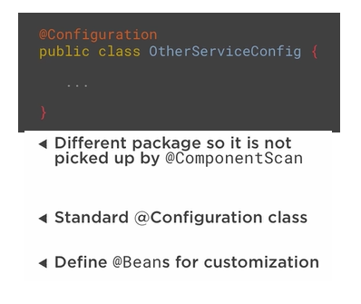
@RibbonClient

Slide 29
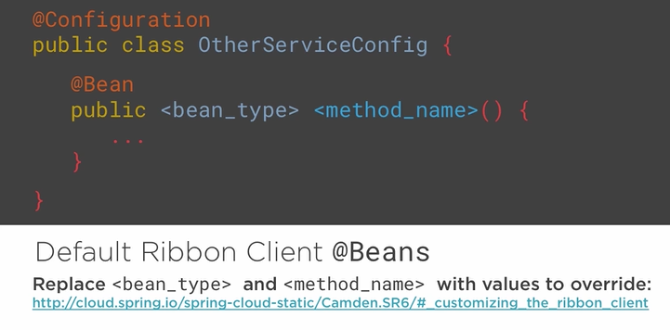
@RibbonClient

Slide 30
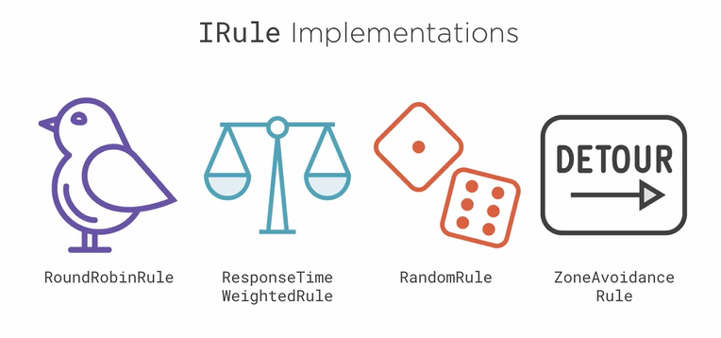
@RibbonClient

Slide 31
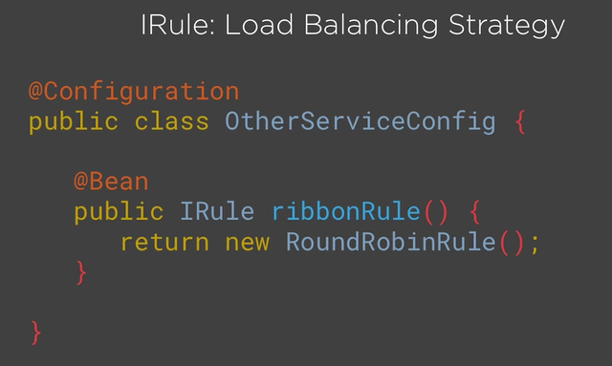
@RibbonClient

